Slide 1
Machine Learning

Slide 2
why ML ?
Growth of web pages
Large database generated from action that happens on Application
Sensors generate new data
Unstructured data
Natural Language Processing
Product Recommendation
Computer Vision
Handwriting Recognition

Slide 3
What is ML (Arthur Samuel & Tom Mitchell ) ?
The field of study that gives computers the ability to learn without being explicitly programmed “Old Definition”
A computer program is said to learn from experience E with respect to some task T and some performance measure P, if its performance on T, as measured by P, improves with experience E ….!

Slide 4
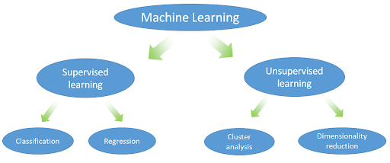
Where is ML ..!
What if I have some data and I do not know the labels of these data …?

Slide 5
Supervised Learning
We know the output so why it's considered a type of ML.
Here is the idea behind, now you know what the actual values of what you already have , but what is about unseen data….!
Imagine you need to predict house price.
Imagine you need to predict the image is dog or cat.

Slide 6
Supervised Learning
Regression
We need to map the input to some “continuous function” of output …!

Slide 7
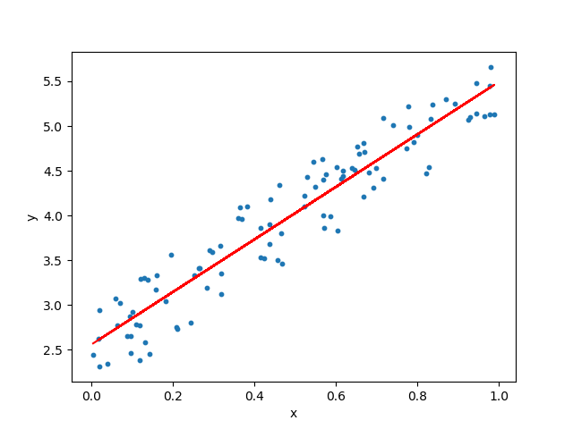
Linear Regression
Fitting Line

Slide 10
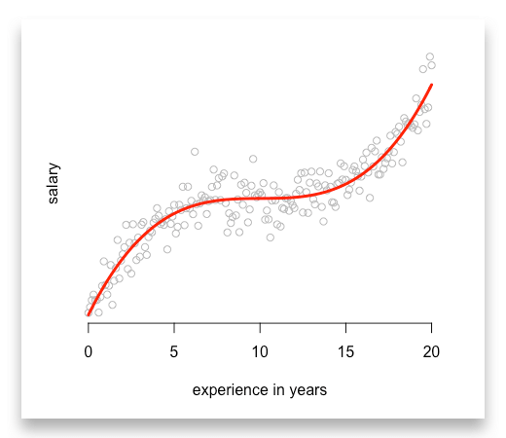
It's not always Linear

Slide 11
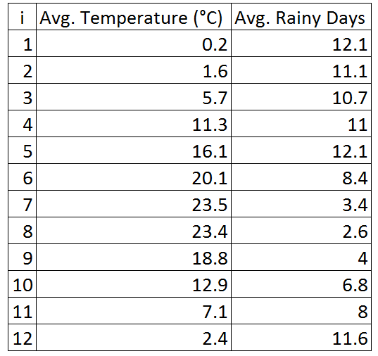
Regression Apps
sales of a product.
House pricing.
Exam Scores.
Salaries.
Others.

Slide 12
Supervised Learning
Classification
We need to map the input to some “discrete values” of output …!

Slide 13
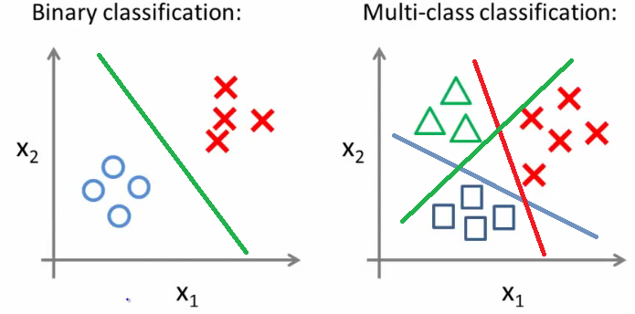

Slide 14
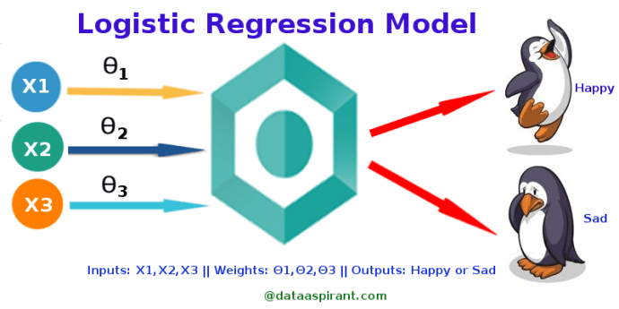

Slide 15
Linear Regression Continuous
Now we took a snapshot of supervised learning with the two main problems its solve:
Linear Regression
Logistic Regression or called (Classification)
Let us now go deeper to Linear Regression - (Next Session).

Slide 16
Three A & ML ^__^
Linkedin
Github
+20 1116259370
Abdelrahmanhamdy33@gmail.com
Contact Info:

